Slide 1
Slide 8
Exception
Dasar-Dasar Pemrograman 1
Semester Ganjil 2016/2017

Slide 2
What counts as exceptions
Runtime errors
  E.q., indexing past the end of a string or a list, trying to open a nonexistent file, etc.
Specific events.
  E.q., search algorithm doesn’t find a value, mail message arrives, time limit has passed, etc.
Dasar-Dasar Pemrograman Ganjil 2016-2017

Slide 3
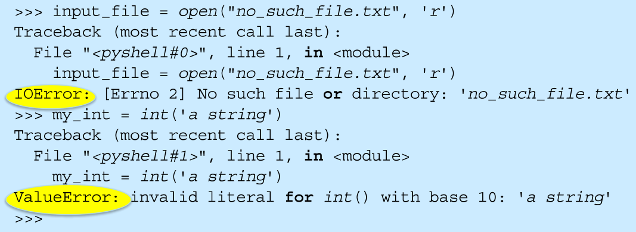
Error Names
Errors have specific names, and Python shows them to us all the time
Dasar-Dasar Pemrograman Ganjil 2016-2017

Slide 4
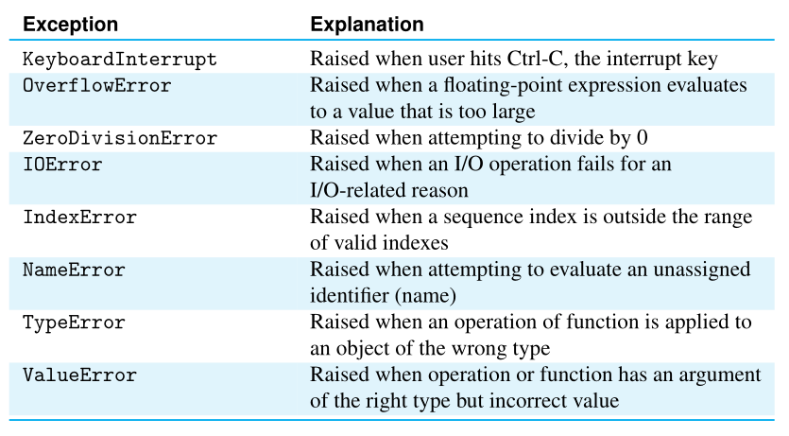
Common Exception Types
Dasar-Dasar Pemrograman Ganjil 2016-2017

Slide 5
Exception handling
Basic idea:
  Keep watch on a particular section of code
  If we get an exception, raise/throw that exception (let it be known)
  Look for a catcher that can handle that kind of exception
  If found, handle the exception, otherwise let Python handle it (which usually halts the program)
Dasar-Dasar Pemrograman Ganjil 2016-2017

Slide 6
Doing better with input
In general, we have assumed that the input we receive is correct (from a file, from the user)
There is always the chance that the input could be wrong
Our programs should be able to handle this
Failure to enforce correct input is a common source of software security problems
Dasar-Dasar Pemrograman Ganjil 2016-2017

Slide 7
Worse yet, input is evil
“Writing Secure Code”, by Howard and LeBlanc
  “All input is evil until proven otherwise”
Most security holes in programs are based on assumptions programmers make about input
Secure programs protect themselves from evil input
Dasar-Dasar Pemrograman Ganjil 2016-2017

Slide 8
General form of exception handling
The try-except statement has the following form:
try:
<body>
except <ErrorType>:
<handler>
When Python encounters a try statement, it attempts to execute the statements inside the body
If there is no error, control passes to the next statement after the try-except statement
Dasar-Dasar Pemrograman Ganjil 2016-2017

Slide 9
General form of exception handling (1)
If an error occurs while executing the body in try block, Python looks for an except clause with a matching error type clause with a matching error type. If one is found, the handler code is executed
The try-except statement can be used to catch any kind of error and provide for a graceful exit
A single try statement can have multiple except clauses
Dasar-Dasar Pemrograman Ganjil 2016-2017

Slide 10
General form of exception handling (2)
The multiple except clauses act like elifs. If an error occurs, Python will try each except clause looking for one that matches the type of error
The bare except clause at the bottom acts like an else and catches any errors without a specific match
If there is no bare except clause at the end and none of the except clauses match, the program would still crash and report an error.
Dasar-Dasar Pemrograman Ganjil 2016-2017

Slide 11


Example
Code:
  Without try-except:
  Output
  With try-except:
  Output:
Dasar-Dasar Pemrograman Ganjil 2016-2017

Slide 12
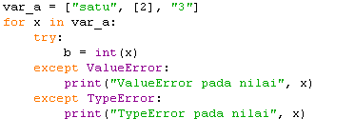

Example (1)
Code:
Output:
Dasar-Dasar Pemrograman Ganjil 2016-2017

Slide 13
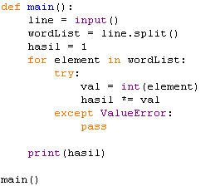
Latihan (1)
Carilah output dari program berikut:
Dasar-Dasar Pemrograman Ganjil 2016-2017

Slide 14
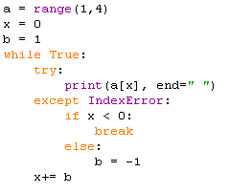
Latihan(2)
Carilah output dari program berikut:
Dasar-Dasar Pemrograman Ganjil 2016-2017

Slide 15
References
William Punch & Richard Enbody. The Practice of Computing using Python, 2nd Edition. Addison-Wesley, 2013
Y. Daniel Liang. Introduction to Programming Using Python. Prentice Hall, 2013.
John Zelle. Python Programming: An Introduction to Computer Science, 2nd Edition. Franklin, Beedle & Associates Inc., 2010.
Mark Lutz. Learning Python, 5th Edition. O’Reilly Media. Copyright 2013 Mark Lutz, 978-1-44-93-5573-9
L. Y. Stefanus. Slide Pelatihan Python. 2015.
Dasar-Dasar Pemrograman Ganjil 2016-2017

